Slide 1

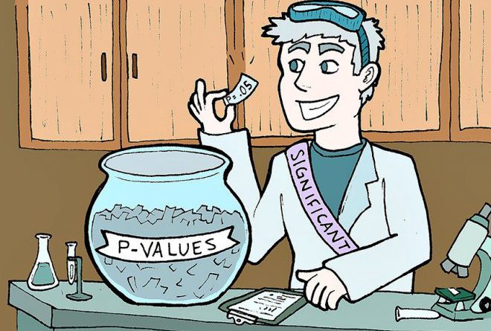
The ps of the Past:
A historical review of p-value reporting in psychology
GABRIEL CRONE & DR. CHRISTOPHER D. GREEN
YORK UNIVERSITY, PSYCHOLOGY

Slide 2
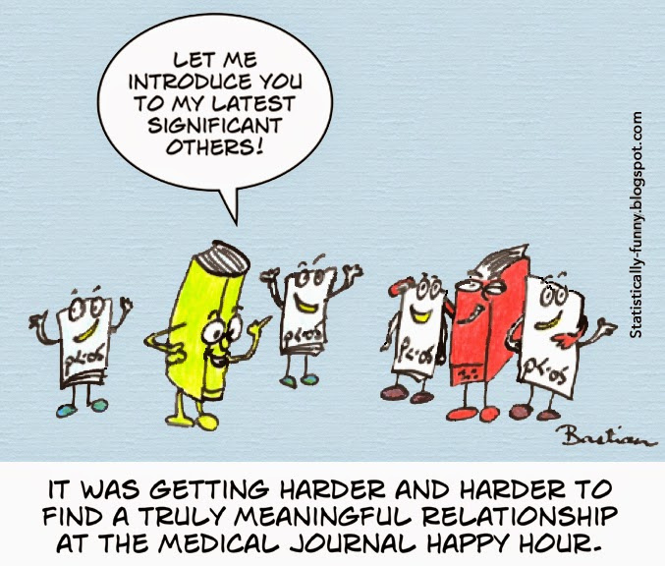
Null hypothesis significance testing (NHST): Very popular system of statistical inference in psychology
p-value: Significance indicator
NHST has long been long criticized (e.g., confusing definition, p-hackable)
Despite replication crisis, NHST is still frequently used
Introduction

Slide 3
What do we know about p-value reporting?
Researchers frequently misreport p-values
p-hacking may be an issue
Misreporting: Reported p-values do not match test statistic and df
Previous studies found p-value reporting errors:
American: 9.7%
Canadian: 6.3%
p-hacking: Using flexibility in analysis decisions to arrive at "significance"
p-hacking may exist in literature, but findings are inconclusive
(Simmons et al., 2011)
(Green et al., 2018; Nuijten et al., 2015)
(Masicampo & Lalande, 2012; Lakens, 2015)

Slide 4
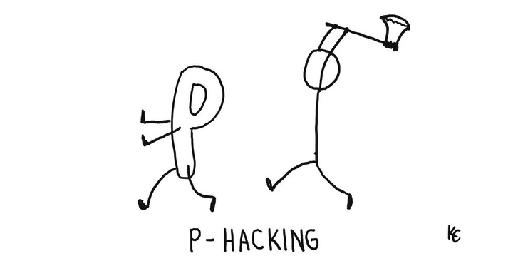
THE BIG QUESTION:
In major journals, is there historical evidence of statistical misreporting and p-hacking?

Slide 5

Sample & Method
Sample: All research articles across seven notable journals from 1945 to 2020 (every 5 years)
Journals: DP, JAbP (including JAbSoP), JApP, JCCP, JEdP, JEP:G, JPSP
All p-values were detected and analyzed with Statcheck
(Nuijten & Epskamp, 2023)

Slide 6
What is Statcheck?
Statcheck = R package that scans article text, checks statistical tests (p-values), and returns useful data:
Re-computed p-values - p-value based on reported test statistics and degrees of freedom
Minor reporting errors - Did the reported p-value differ from the re-computed p-value?
Major reporting errors - Did a reporting error cause p < .05 to become p > .05 (or vice versa)?

Slide 7
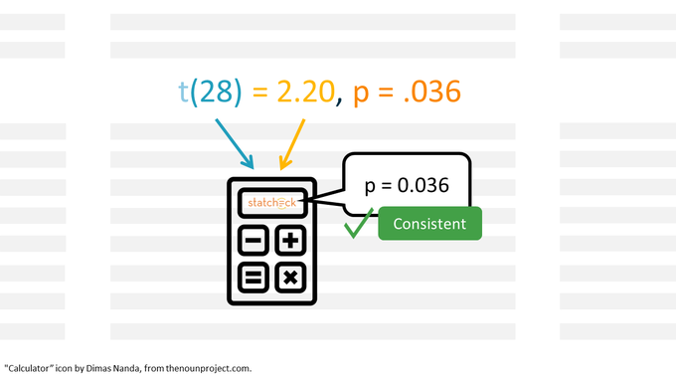
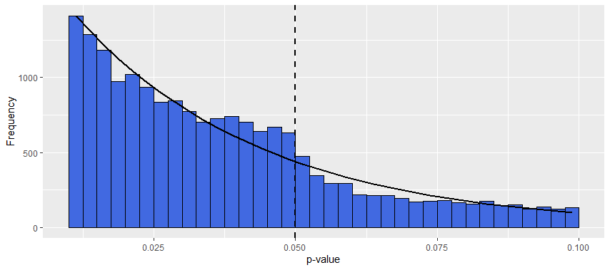
Addressing Research Questions
1) Statistical Misreporting
2) p-hacking
Summarize % of major and minor reporting errors
Visually inspect p-value distributions for .05 "jump" with histograms and curves
Addressing Research Questions

Slide 8
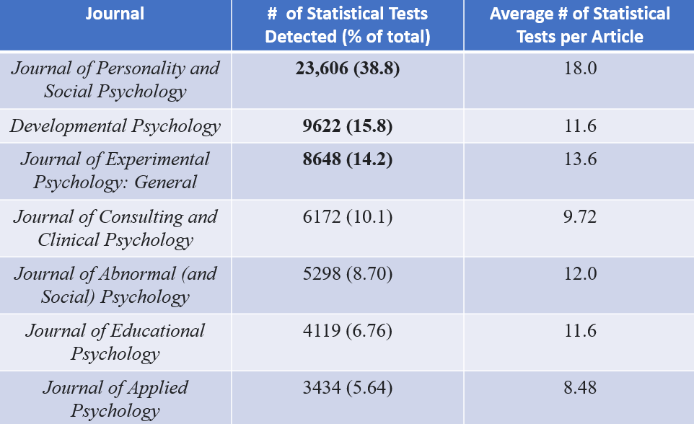
Database
From 10,409 articles, Statcheck detected 60,793 p-values
~ Zero p-values detected before 1965
Some journals were more represented in the data than others

Slide 9
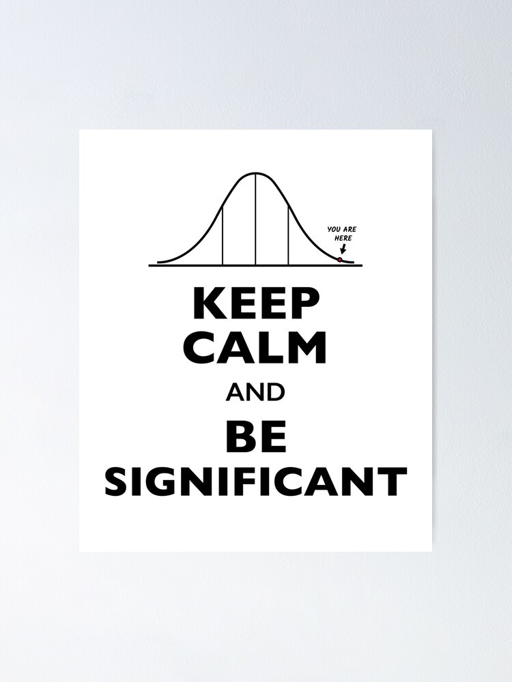
Across all data (60,793 ps)...
14.7% (8947 ps) had minor errors
3% (1845 ps) had major errors
Curvilinear trend over time, but seems to be stabalizing
Overall Reporting Errors

Slide 10
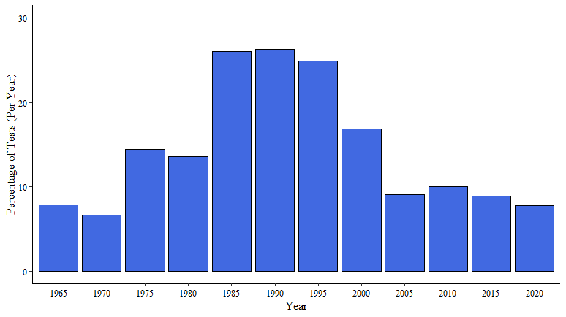
Minor Reporting Errors over Time

Slide 11
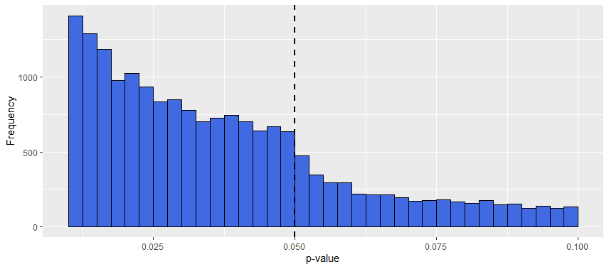
Histogram across all p-values

Slide 12
Histogram across all p-values

Slide 13


Histogram across all p-values
Check values just below .05 and around .05

Slide 14
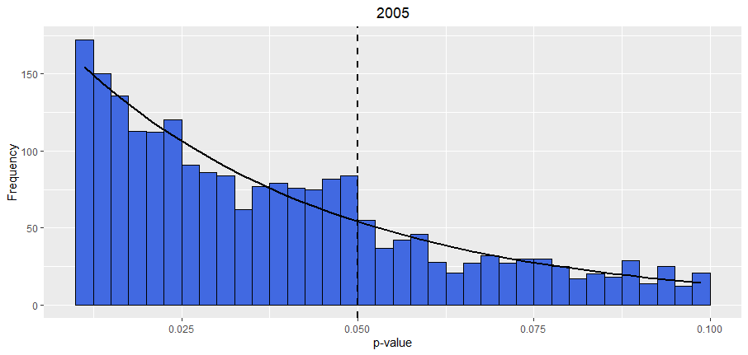
Instance of clear p-hacking
"Jump" just below .05.

Slide 15
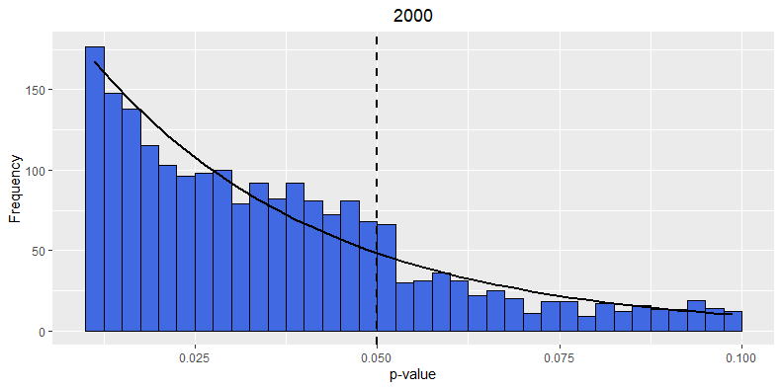
Instance of no p-hacking
No "Jump" just below .05.

Slide 16
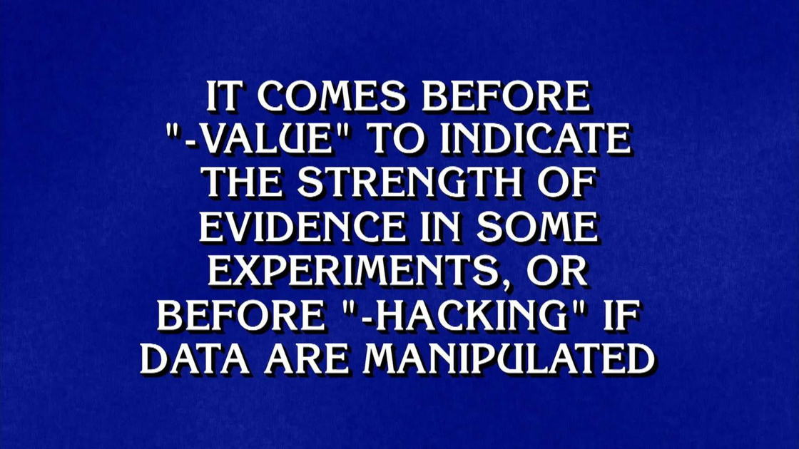
Overall: Modest-to-little p-hacking
But, p-hacking becomes noticeable within specific years
1975 to 1990, 2005, 2010
p-hacking is still cause for concern
p-Hacking Key Results

Slide 17
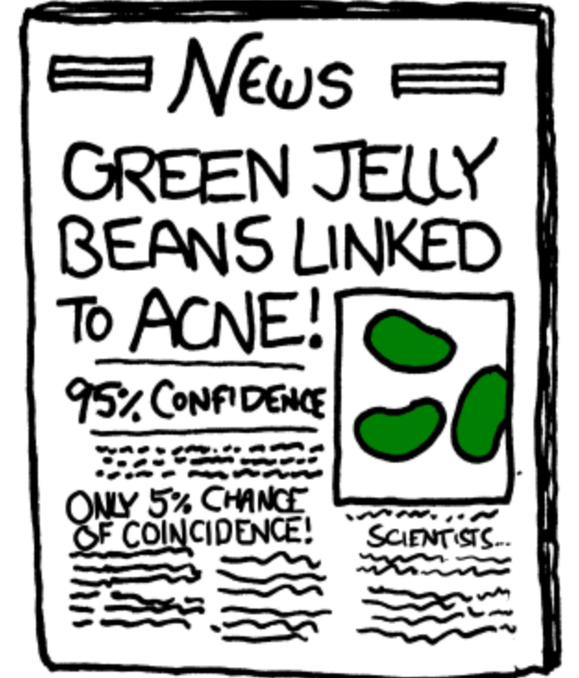
Limitation: Statcheck has accuracy limitations (potentially missed p-values)
Implication: Statistical misreporting and p-hacking are issues that still need to be addressed
Future direction: Assessing p-values in more focused sub-samples using p-curve analyses
Discussion

Slide 18
References
Green, C. D., Abbas, S., Belliveau, A., Beribisky, N., Davidson, I. J., DiGiovanni, J., Heidari, C., Martin, S. M., Oosenbrug, E., & Wainewright, L. M. (2018a). Statcheck in Canada: What proportion of CPA journal articles contained errors in the reporting of p-values? Canadian Psychology, 59(3), 203–210. https://doi.org/10.1037/cap0000139
Lakens, D. (2015). What p-hacking really looks like: A comment on Masicampo and LaLande. The Quarterly Journal of Experimental Psychology, 68(4), 829–832. http://dx.doi.org/10.1080/17470218.2014.982664
Masicampo, E. J., & Lalande, D. R. (2012). A peculiar prevalence of p values just below .05. The Quarterly Journal of Experimental Psychology, 65(11), 2271–2279. http://dx.doi.org/10.1080/17470218.2012.711335
Simmons, J. P., Nelson, L. D., & Simonsohn, U. (2011). False-positive psychology: Undisclosed flexibility in data collection and analysis allows presenting anything as significant. Psychological Science, 22(11), 1359–1366. https://doi.org/10.1177/0956797611417632
Nuijten, M. B., & Epskamp, S. (2023). statcheck: Extract Statistics from Articles and Recompute P-Values. R package version 1.4.0. https://CRAN.R-project.org/package=statcheck
Nuijten, M. B., Hartgerink, C. H. J., van Assen, M. A. L. M., Epskamp, S., & Wicherts, J. M. (2015). The prevalence of statistical reporting errors in psychology (1985–2013). Behaviour Research Methods, 48, 1205–1226. https://doi.org/10.3758/s13428-015-0664-2

Slide 19


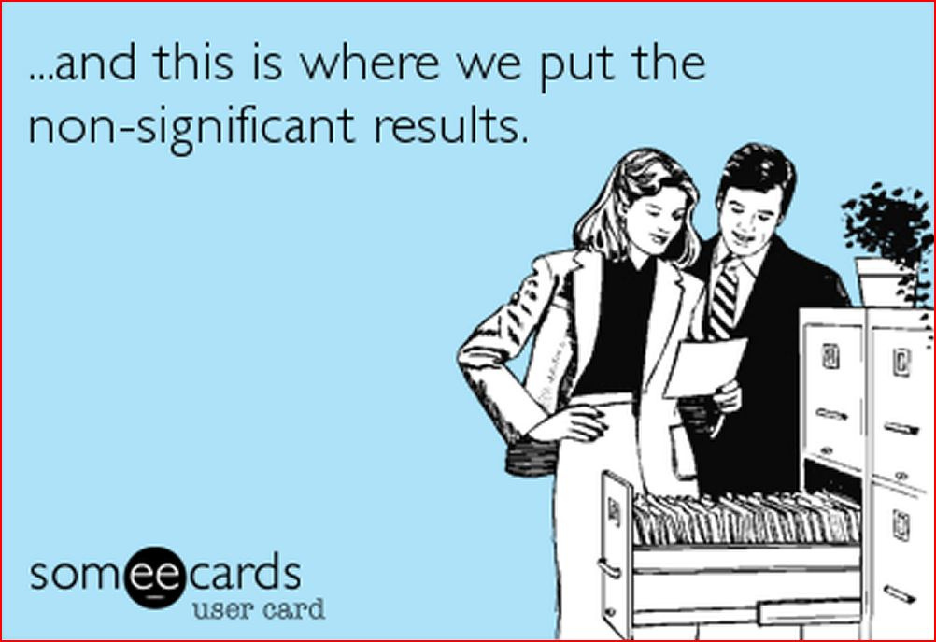
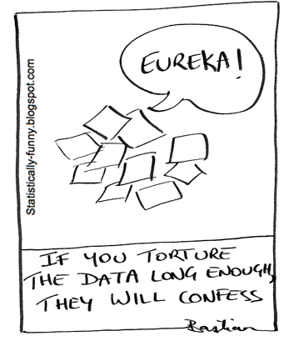
QUESTIONS?

Slide 20
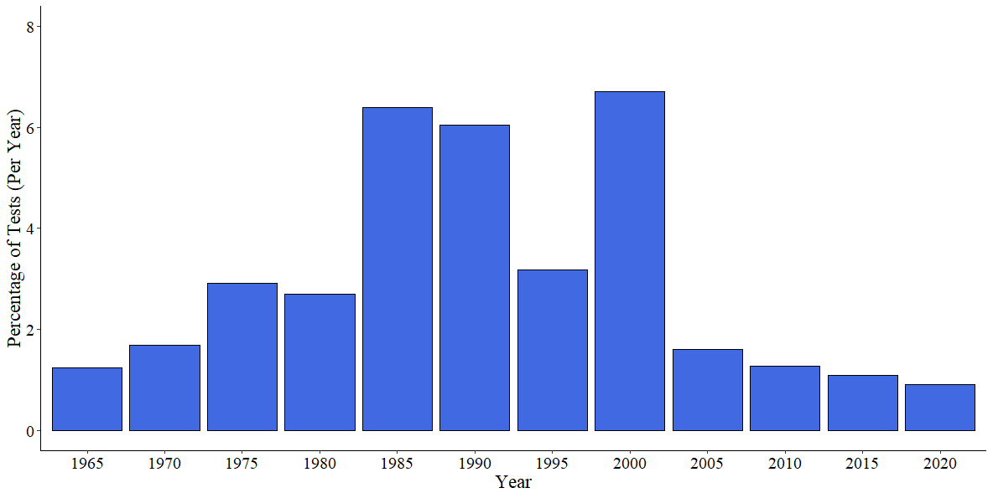
Major Reporting Errors over Time

Slide 21
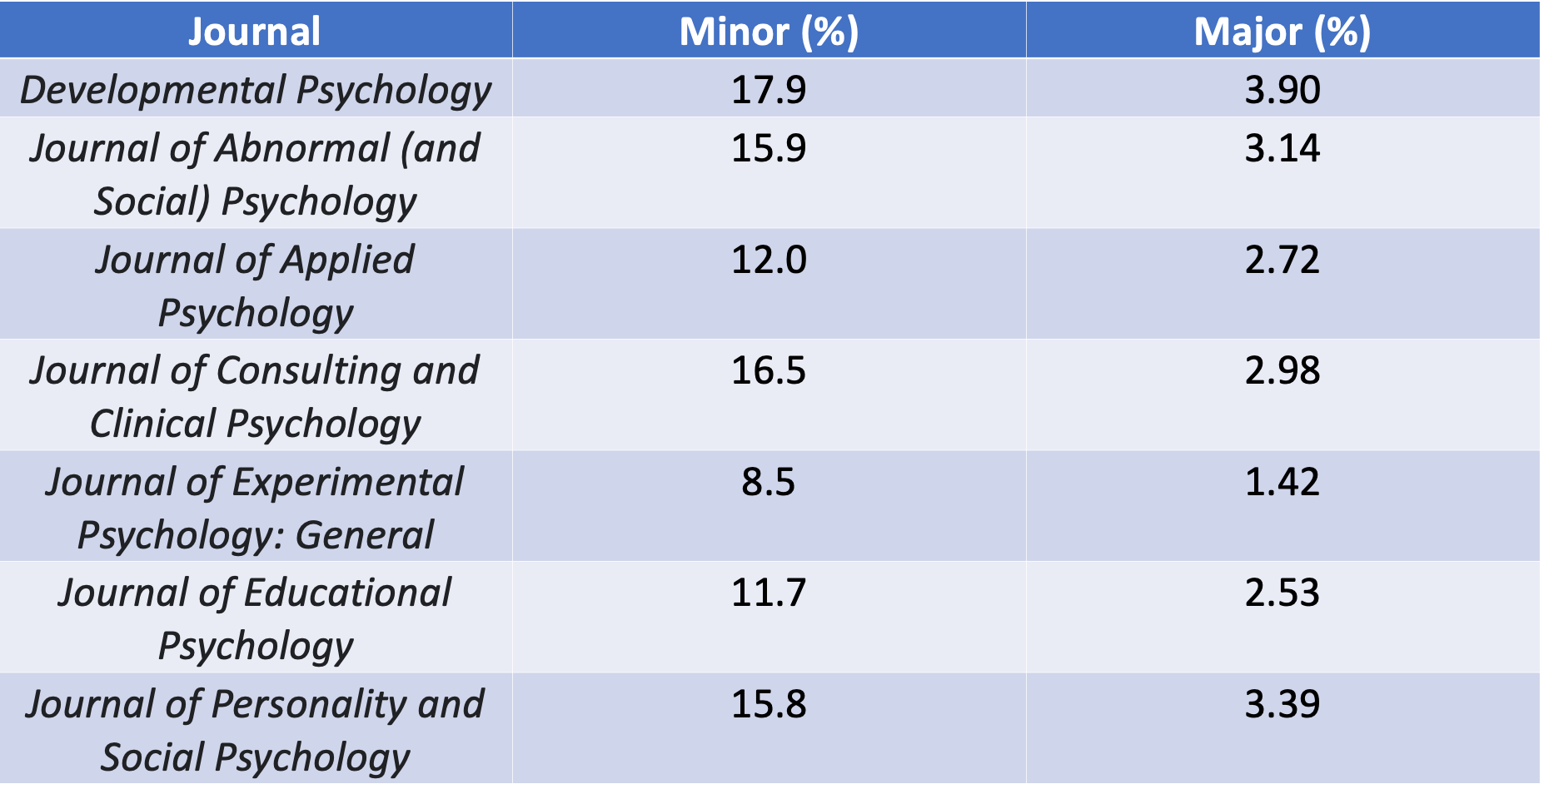
Major & Minor Errors by Journal

Slide 22
p-Hacking by Journal
When plotting seperate journals, some had higher prevalence of ps just below .05 than others
Journals with the most noticable p-Hacking:
Journal of Applied Psychology
Journal of Experimental Psychology
Journal of Educational Psychology
All other journals had little to no evidence of p-hacking

